Slide 1
Data Science Assignment – 1 Top Mentor

Slide 2
Agenda
Introduction
Problem Statement and Data Source
Objective & Methodology
Solution Description
Impact

Slide 3
Introduction
Assignment 1.1
Analysis of a Local Running Shop in BTM Layout,Bangalore
Assignment 1.2
Opening of a Wada Pav Shop near Shivaji Nagar in Pune

Slide 4
Problem Statement & Data Source
Understanding the trend and pattern of the shops near BTM Layout,Bangalore & Sivaji Nagar, Pune which are suggested by the clients and help in optimizing the results for operation of their shops and incubation of the shop which will result in minimum risk and medium investment.
The Main Focus of this being assisting the shopowner with sustaining his shop .
Helping incubate the Vada Paw shop in Pune.
Data is Collected from Zomato and the inputs provided by Mr. Rao.
Food prices

Slide 5
An Overview of the problems
1. A man has took a shop in Rent near BTM Layout, Bangalore, not in the main road but as a local shop. The rent of the shop is 14000 per month. The man took the shop to sell fast food like -Biryani, Maggie, Egg Bhujia, Omelets, Chicken Kabab etc.
a. In the first 3 months he make a profit of around 100000, with a sales of around 300000.
b. In the 1stmonth he was selling veg food also, but he stopped after the 2ndmonth as it stock was not getting out.
c. After 4 –5 months down the line the man is making a huge loss in his investment. He has a due of 2 months to pay the rent.
d. The sale has drastically gone down and he is thinking to close the shop.
e. The Man is very lazy in working hard and also very poor in any other investment.How will you tackle a situation of this kind?
Write a solution to this kind of problem. Give a Fact-full answer by understanding the critical problems

Slide 6
An Overview of the problems
2. A man wants to open a Wada Pav Shop near Shivaji Nagar in Pune. He has got a location where there are other 4 more wada pav shops. He is not able to understand what will be the strategy to take over his clients.
a. What will be the price of each Wada Pav?
b. How will he differentiate from the other competitors?
c. How will you bring insights when he has no data of his shop?
d. Why will be the Customer comes to your shop? (What will be the positioning)

Slide 7
Objective & Methodology
Assisting the shop owner in Bengaluru with keeping his Business Running
Identifying the Areas of opportunities and fixing any issues.
Assisting with setting the Vada Pav store in Pune.
Also providing insights of competing stores nearby

Slide 8
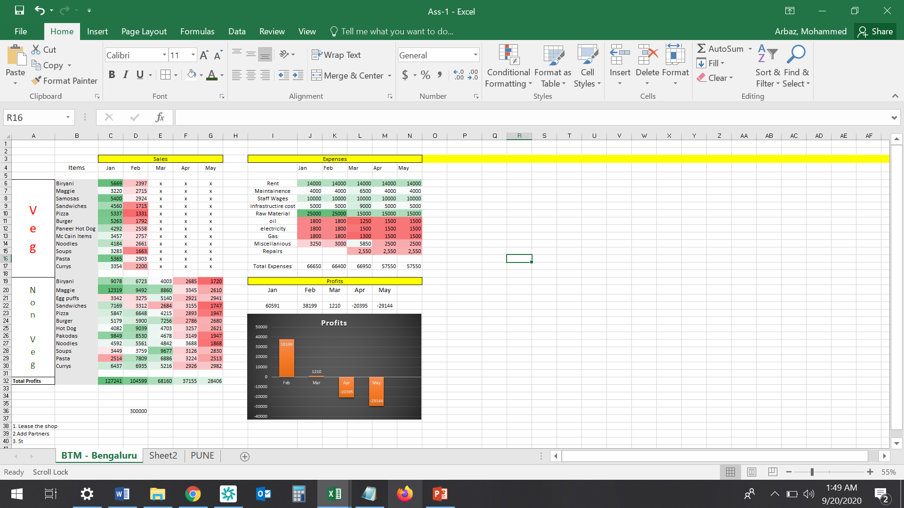
Solution Description -1.1
As per the insights and the screenshots provided below, Following are my solution advises:
1. In both the categories the biggest drop was for the following items:
Veg: Sandwiches, Pizza , Burger , Soups
Non- Veg :Biryani, Sandwiches, Pizza, Pakodas, Noodles
These caused losses and would take extra material to prepare for lesser Items.
I would suggest looking out for options that are not just confined to a single product and can be used for multiple Items

Slide 9
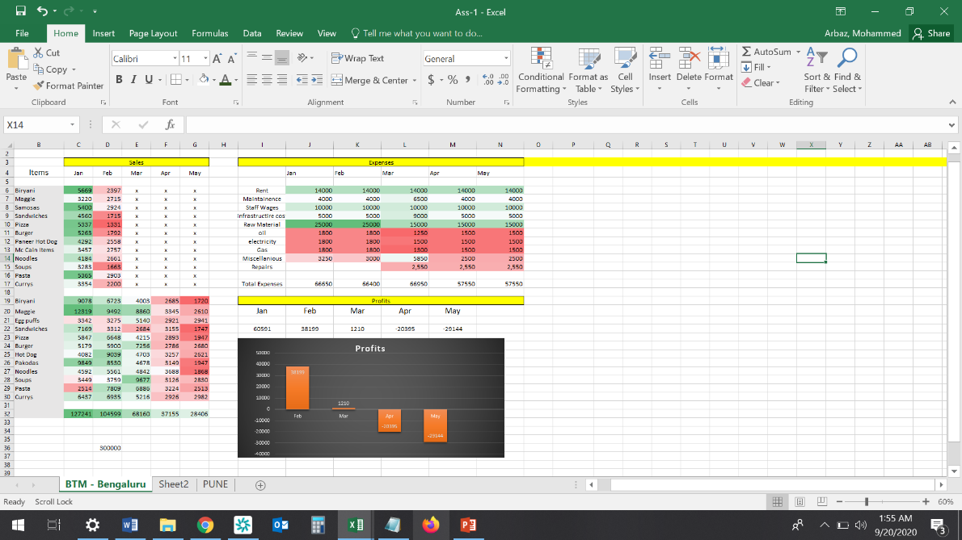
Solution Description -1.1
2. Focusing on shortening the menu and providing a better taste. The most profitable were:
samosas, Maggie in Veg
Currys, Soups, Hot dog, Burger & egg puffs in Non Veg
This would also help in reducing the Raw Material Cost, Oil and even Wages if an extra employee can be let go
Other Options to Consider:
1. Leasing the shop to someone else
2. Replacing few non profitable items with juices & tea and experimenting
3. Marketing, Partnering with
Swiggy /Zomato

Slide 10
Solution Description -1.2
Competitors nearby | For each VADA PAV | Timings
aadhya-amruttulya-budhwar-peth | 15 | from 8:00 Am
wadeshwar-fc-road | 120 | from 12:30 pm
triveni-1-fc-road | 15 | from: 7:00 AM
imdr-canteen-fc-road | 15 | from: 7:30 AM
joshi-wadewale-shivaji-nagar | 15 | from 8:00 Am
Top Competitors in Shivaji Nagar |  | Timings
Joshi Wadevale | 15 | 8am - 10pm
R'Adda | 249 | 5pm – 12midnight
Santosh Bakery | 25 | 7am – 1pm, 4pm – 9pm
Hakuna Matata | - | 11:30am – 12midnight
Based on the information collected, below is a deepdive on the ingredients:
Batata Vada (Serves 12 nos) -
400 gms potatoes (boiled) | 18
1 tbsp garlic | 2
1 green chilly crushed | 14
1 tsp mustard seeds | 2.5
a pinch of asafoetida | 5
1/4 tsp turmeric powder | 2.5
10 nos curry leaves | 2
2 tbsp coriander leaves | 2
salt as required | 2
for batter
1.5 cups gram flour | 10
½ cup water or as required | 2
salt as required | 2
for red chutney
3 tbsp red chili powder | 5
10-12 garlic cloves | 2
Salt as required | 2
Observations:
The pricing competitors have are aggressive.
The total is costing: 73 Rs for 12 Vadas which equals
6.08 Rs Per Vada
If he makes buns, the prices will go up significantly.
It would be cheaper to purchase bun directly

Slide 11
Solution Description -1.2
a. What will be the price of each Wada Pav?
Due to the aggressive pricing, by our competitors, we will have to sell at 15 Rs Each as well.
b. How will he differentiate from the other competitors?
Selling monthly Vouchers (Prepaid rechargeable cards) pay once for 30 pavs (limit 2 pavs a day )
Unlimited Chatnis, Clean Drinking Water
UPI payments
Investing more on branding (LED signs) to attract customers at non prime time (Night)
Introduce trendy combos which can fetch higher profits.
c. How will you bring insights when he has no data of his shop?
Set up the shop on Zomato, Swiggy, Google etc and keep it updated
Start keeping track of customer feedback from Day -1
d. Why will be the Customer comes to your shop? (What will be the positioning)
Unlimited Chatni & Sauces
Cleaner & sanitized shop,
Faster Payments,
More staff to accommodate Peak hours

Slide 12
Business Impact
Increases Longevity of the Shops with scope of Improvement.
Potential for both businesses to do better.

Slide 13
THANK YOU FOR YOU ATTENTION
Mohammed Arbaz 8309428247
Mail: arbazasif@gmail.com
IG:@Arbazigar

